Slide 1
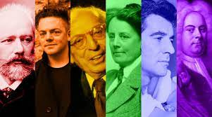
Music that…
…is by LGBT+ composers.
Notes:
As we are in Pride Month, this week’s pieces are all written by LGBT+ composers.

Slide 2
Word(s) of the week…
Composer
A composer is a person who writes music, which can be their profession.
Notes:
I have chosen composers from the Western Classical tradition this week.

Slide 3
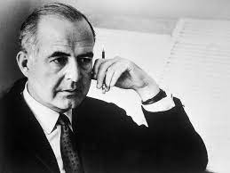
Monday
‘Adagio for Strings’
by
Samuel Barber
Notes:
Samuel Barber was an American composer and this is probably his most well-known piece. It is an arrangement for string orchestra of the second movement of his string quartet op.11. His life partner was another composer, Gian Carlo Menotti. https://www.yout-ube.com/watch?v=N3MHeNt6Yjs

Slide 4
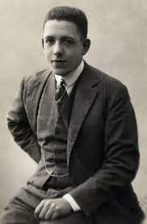
Tuesday
‘Flute Concerto I: Allegro Malinconico’
by
Francis Poulenc
Notes:
Francis Poulenc was a French composer who was largely self-taught. This piece is a 3-movement work for flute and piano and the Italian name for this movement means quickly and in a melancholy style. He did father a daughter but his longest romantic relationships were with men. https://www.yout-ube.com/watch?v=5no21--FPAY

Slide 5
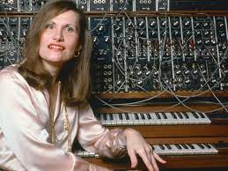
Wednesday
‘Theme from Tron’
By
Wendy Carlos
Notes:
Wendy Carlos is an American composer who is best known for her electronic music and film scores. This is part of her soundtrack to the 1982 film Tron, which was about a person becoming trapped inside a computer game. She began life as Walter Carlos and then transitioned, coming out in the late 1970s. She was the first transgender winner of a grammy award. https://www.yout-ube.com/watch?v=TPF7CXUgcus

Slide 6
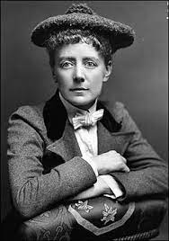
Thursday
‘Serenade in D major II: Scherzo. Allegro Vivace’
By
Dame Ethel Smyth
Notes:
Dame Ethel Smyth was an English composer and a member of the women’s suffrage movement. This piece is part of a 4-movement composition but only the first and last movements are written for full orchestra – this is scored for a chamber ensemble. She made no secret of her relationships with women throughout her life. https://www.yout-ube.com/watch?v=_s7kAAFo5Ss

Slide 7
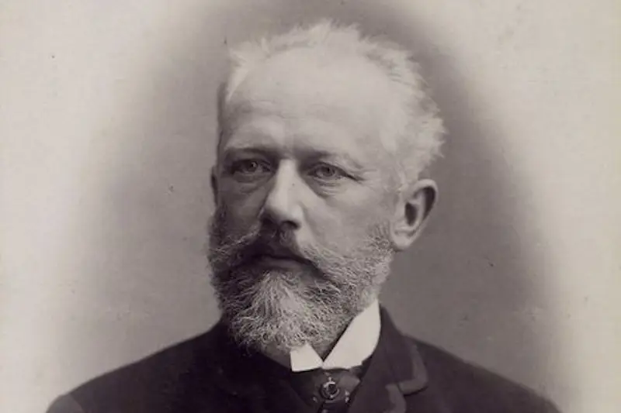
Friday
‘Piano Concerto No.1’
By
Pyotr Ilyich Tchaikovsky
Notes:
Tchaikovsky was a Russian composer of the Romantic period. The opening to this piano concerto is very bold and dramatic and it is probably one of the best-known piano concertos of all time. In letters from Tchaikovsky which have been studied recently, he expresses his love for men. https://www.yout-ube.com/watch?v=hNfpMRSCFPE

