Slide 1

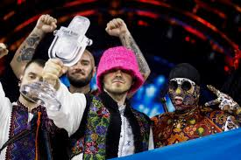
Music that…
…won the Eurovision Song Contest.
Notes:
The Eurovision Song Contest began in 1956 and was inspired by the Italian Sanremo Music Festival. The idea was to have European countries taking part in a televised song contest watched around Europe. The UK decided not to be involved in the first contest but took part from the 2nd year onwards. As this year’s final will take place on Saturday 13th May, I have used it as the focus for this week. The tradition is that the winner of each contest hosts the competition the next year.

Slide 2
Word of the week…
collaboration
In musical terms, a collaboration is where a group of musicians come together to create a piece or performance.
Notes:
Introduce the word of the week, collaboration. This word is particularly relevant to Eurovision because performers from many different countries come together to create a show. Also, this year’s competition is being held in Liverpool, UK even though last year’s winners were Ukraine. The countries are working together to create the show and a strong message from the competition is inclusivity and being a musical community across Europe.

Slide 3
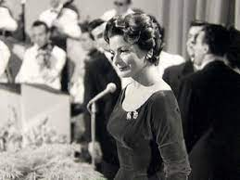
Monday
‘Refrain’
by
Lys Assia
Notes:
The first ever Eurovision Song Contest was held in Lugano, Switzerland, in 1956. Only 7 countries took part: Belgium, France, Italy, Luxembourg, the Netherlands, Switzerland and West Germany. Each country performed 2 different songs and they were only allowed to have solo performers – no groups. The winner was the host country, Switzerland, with the song Refrain, performed by Lys Assia. It is sung in French. https://www.yout-ube.com/watch?v=muaEpHexmwg

Slide 4
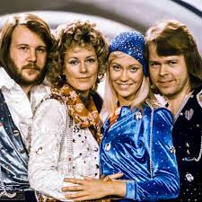
Tuesday
‘Waterloo’
by
Abba
Notes:
We jump to 1974, when the contest was held in Brighton, UK. The Swedish pop group ABBA won with their catchy, up-tempo song Waterloo and shot to fame in the UK, where they have remained popular to this day. Until 1973, there was a rule that every performer should sing in their own home language but this changed in 1974 and ABBA became the first group to win whilst singing in something other than their own first language. https://www.yout-ube.com/watch?v=k2IEcpmvG3g

Slide 5
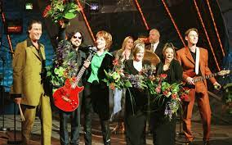
Wednesday
‘Love Shine a Light’
By
Katrina & The Waves
Notes:
The last time the UK won Eurovision was in 1997, although we came close last year! The contest was held in Dublin, Ireland and Katrina & the Waves gave the UK their first win since 1981. The song has a very positive message about love bringing people together. https://www.yout-ube.com/watch?v=NnoikRec67k

Slide 6
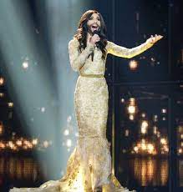
Thursday
‘Rise Like a Phoenix’
By
Conchita Wurst
Notes:
The 2014 competition was held in Copenhagen, Denmark and was won by Austrian singer Tom Neuwirth, who performs as Conchita Wurst. This piece is a powerful ballad, sounding rather like a Bond theme.

Slide 7
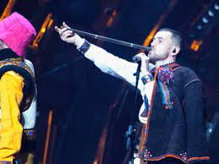
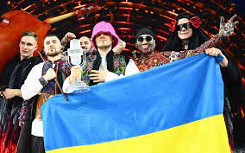
Friday
‘Stefania’
By
Kalush Orchestra
Notes:
So we come to last year’s competition winner – Ukraine. The competition was held in Turin, Italy and the group combine folk and rap elements in their song. Two traditional Ukrainian woodwind instruments, the sopilka and the telenka, feature heavily in the song. https://www.yout-ube.com/watch?v=F1fl60ypdLs

