Slide 1
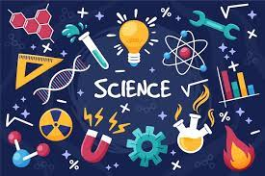

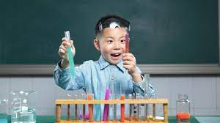

Music that…
…is inspired by Science.

Slide 2
Word of the week…
If an object vibrates, it causes the air molecules to vibrate and creates sound waves. If these enter our ears, we hear them as sound.
Sound
Notes:
I’ve included a simple scientific explanation of sound this week to fit with the theme. If you want to watch a video about how this works, here is a link: https://www.bbc.co.uk/teach/class-clips-video/music--science-ks2-what-is-sound/zbnmhbk#:~:text=If%20an%20object%20vibrates%20the,then%20we%20hear%20the%20sound.

Slide 3
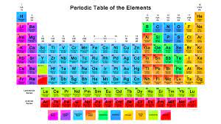
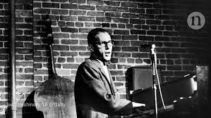
Monday
‘The Elements Song’
by
Tom Lehrer
Notes:
Tom Lehrer is an American singer-songwriter and mathematician who wrote a number of humorous songs. This one is sung to the tune of The Major-General’s Song from The Pirates of Penzance by Gilbert & Sullivan. The lyrics recite elements from the periodic table, which is a visual catalogue of all the known elements. At the time of writing it (1959) there were only 102 known elements but, since then, a further 16 elements have been added. https://www.yout-ube.com/watch?v=U2cfju6GTNs

Slide 4
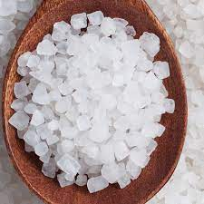

Tuesday
‘NaCl (Sodium Chloride)’
by
Kate & Anna McGarrigle
Notes:
Kate & Anna McGarrigle were a Canadian singer-songwriter duo. NaCl is the chemical symbol for Sodium Chloride (otherwise known as ‘salt’). This song creates a love story between the Chlorine and Sodium elements, with some scientific explanation along the way. https://www.yout-ube.com/watch?v=0wRRAkvQ2RA

Slide 5
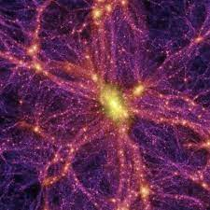

Wednesday
‘Dark Energy’
By
Kelly-Marie Murphy
Notes:
Kelly-Marie Murphy is a Canadian composer who has won a number of prestigious awards. In science terms, Dark Energy is an antigravity force in space, first suggested by Einstein in 1917. In 2006, the New York Times described it like this: “Because it is a property of empty space, the overall force of Einstein’s constant grows in proportion to the expanding universe until it overwhelms everything.” Murphy’s music is written for string quartet and begins softly and simply. It builds up, becoming more and more complex. https://www.yout-ube.com/watch?v=XMMiVKWG7Ds

Slide 6
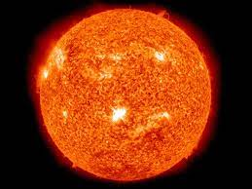
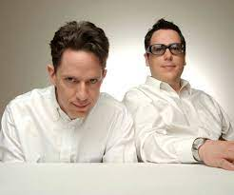
Thursday
‘Why Does the Sun Shine?’
By
They Might Be Giants
Notes:
They Might Be Giants is an American alternative rock band. This song was released on their album Here Comes Science, aimed at teaching children about science through song. https://www.yout-ube.com/watch?v=3JdWlSF195Y In true scientific style, they later released a new song Why Does the Sun Really Shine? to include information which wasn’t known originally . The lyrics have changed from ‘The sun is a mass of incandescent gas’ to ‘The sun is a miasma of incandescent plasma’! You can hear it here: https://open.spotify.com/track/5C5Cbp9pp3uycVbijcL6o3?si=af7d767f74ac4871

Slide 7

Friday
‘Think Like a Scientist’
By
Blazer Fresh
Notes:
This is another song designed to teach children about science. The rappers Blazer Fresh are from the GoNoodle site and here they go through a list of scientific skills. https://www.yout-ube.com/watch?v=PnZXm6vIr6g

