Slide 1
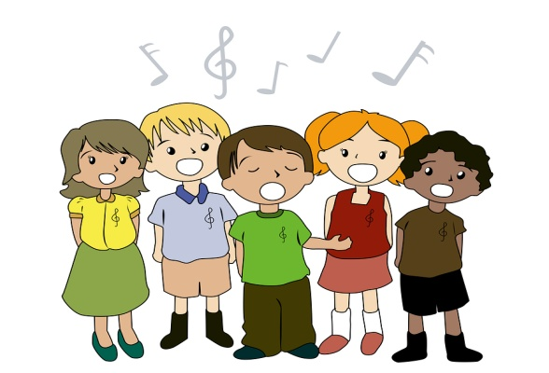
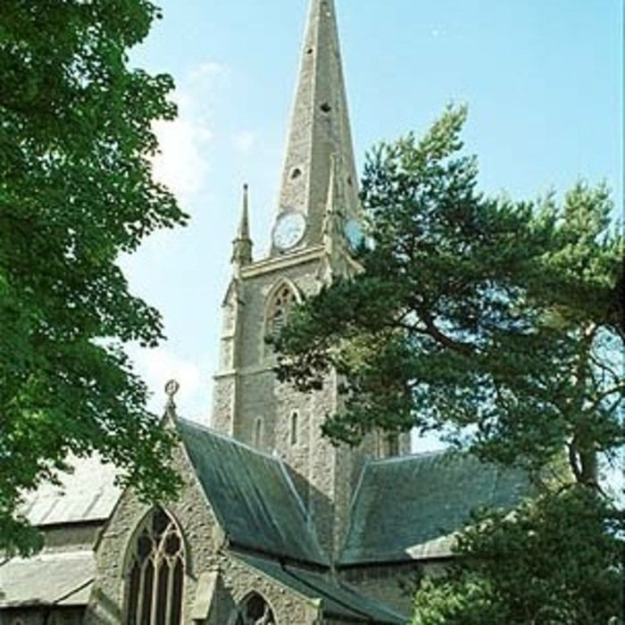
Music that…
…is about the All Saints’ CE Primary School.

Slide 2

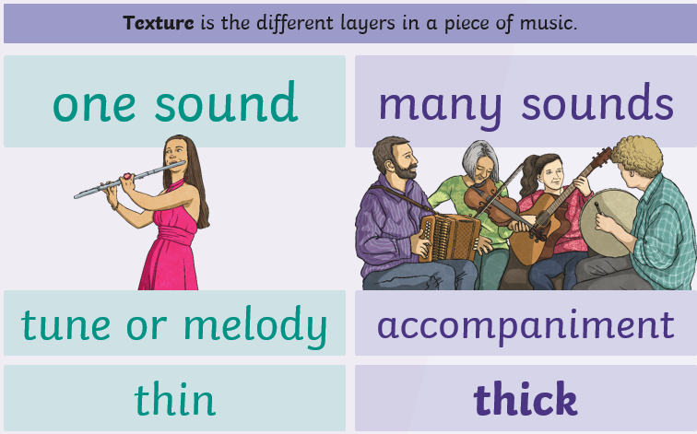
Word of the week…
Notes:
Introduce the word of the week, texture. This word should be familiar in other contexts such as Art & Design. In music, it refers to the different layers of sound which can be heard. Sometimes, there is only one instrument or voice (solo), sometimes two (duet) or more. Within the same piece, there may be times when there is only one melodic line and other times when there are many layers. These could involve all parts playing the same line or different parts playing different notes. Encourage the children to listen carefully to each piece – is there one person performing or more? Are they performing the same part or different parts? Does this change throughout the piece?

Slide 3
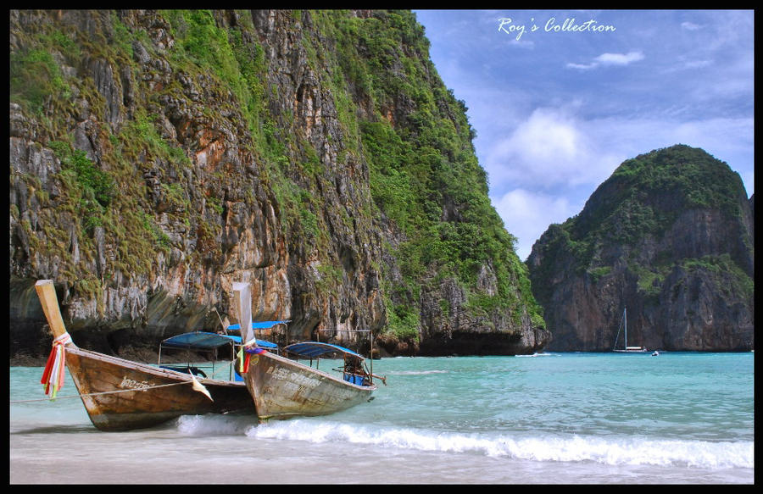
Monday
‘Pure Shores’
by
All Saints
https://www.youtube.com/watch?v=dVNdTXEJv1A
Notes:
All Saints

Slide 4
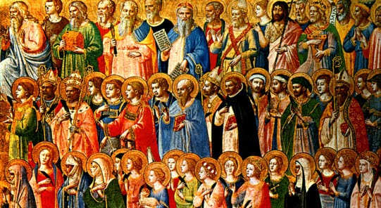
Tuesday
‘THE LITANY OF THE SAINTS
– Gregorian Chant
https://www.youtube.com/watch?v=jb23Z5X3uhA
Notes:
THE LITANY OF THE SAINTS – Gregorian Chant
https://www.youtube.com/watch?v=jb23Z5X3uhA

Slide 5
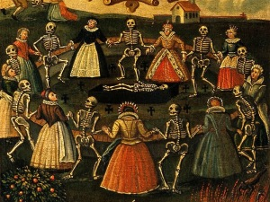
Wednesday
Camille Saint-Saëns –
Danse Macabre
https://www.youtube.com/watch?v=YyknBTm_YyM

Slide 6
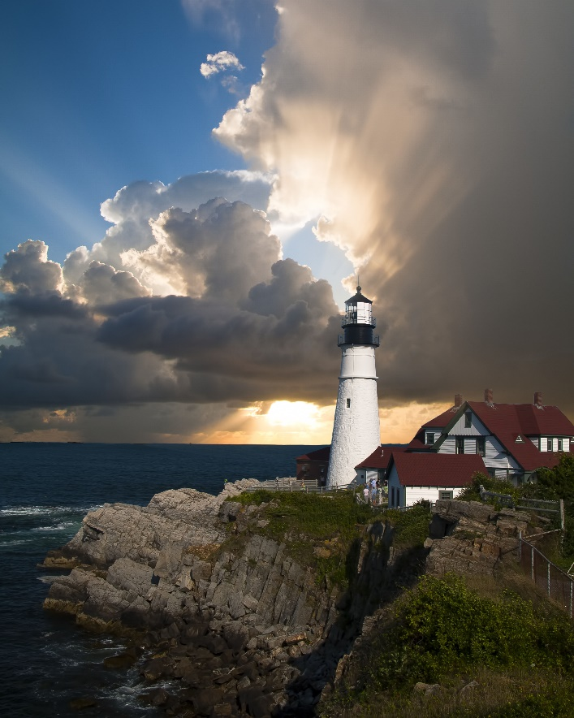
Thursday.
Rend Co. Kids –
My Lighthouse (Hand Motions)
(Official Music Video)
https://www.youtube.com/watch?v=JeJvKkBV6rY

Slide 7

Friday
‘O When the Saints/
Swing Low/This Train/
I’m Gonna Sing (Partner Songs)
https://www.youtube.com/watch?v=fMItGSu9LaU

Slide 8
Oh when the saints
Go marching in
Oh when the saints
Go marching in
Oh how I want to be in that number
Oh when the saints
Go marching in.
Swing Low, Sweet Chariot
Coming forth to carry me home
Swing Low, Sweet Chariot
Coming forth to carry me home.
This train is bound for Glory this train (whoo hoo)
This train is bound for Glory this train (whoo hoo)
This train is bound for Glory
Nothing rides but the righteous and the holy
This Train is bound for Glory this train.
I’m gonna sing, sing, sing!
I’m gonna shout, shout, shout!
I’m gonna sing, I’m gonna shout, Praise the Lord.
When those gates are opened wide,
I’m gonna sit by Jesus’ side,
I’m gonna , sing I’m gonna shout, Praise the Lord.

